Slide 1
Recursive Least Squares Algorithm
By: Jacob Kirschner & Mason Wilie

Slide 2
What is RLS
Recursively finds the coefficients to minimize a weighted linear least squares cost function
Similar to LMS, but accounts for past information, rather than just present information
Update covariance matrix scaled by a forgetting factor (0<ƛ≤1) meaning the filter is more sensitive to the most recent samples
Will converge faster than LMS algorithm at cost of high computational complexity

Slide 3
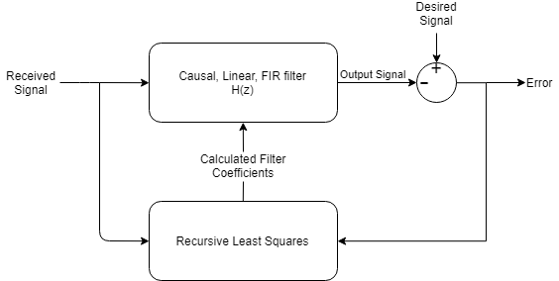
Block Diagram

Slide 4
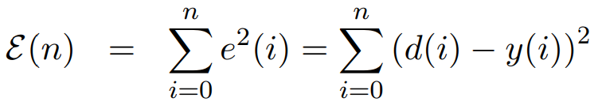
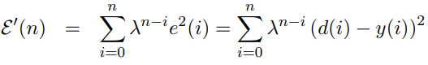
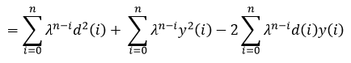
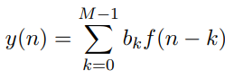
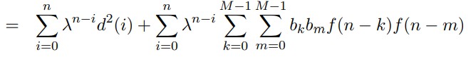
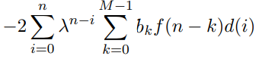
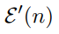
Basis

Slide 5
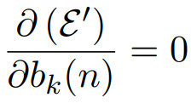
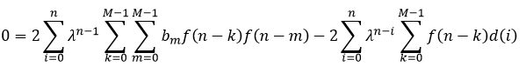
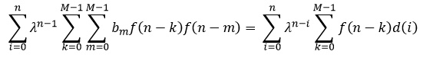
Basis continued...

Slide 6
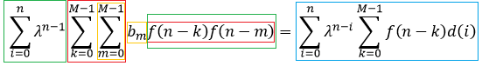
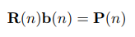
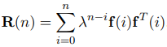
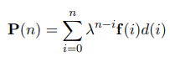
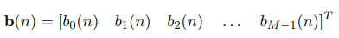
Basis continued… but with matrices now

Slide 7
Linear algebra, my favorite
Not trying to solve the equation for each available sample
Recursively compute R(n) using the following equation
But then we need to find a way to compute the inverse of R(n) efficiently
The Matrix Inversion Lemma - “If a square nonsingular N×N matrix A, with known inverse A⁻¹ is updated with an additive term the new inverse is given by” [1]

Slide 8
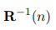
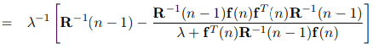
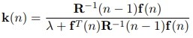
Linear algebra, no longer my favorite
Let A = R⁻¹(n-1), B = f(n), C = ƛ⁻¹
We will define a vector k(n) of kalman gains to simplify the equation above
Similarly for P(n), though we don’t need the inverse

Slide 9
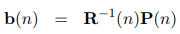
How does any of this help?
The best part is...

Slide 10
It’s Recursive

Slide 11
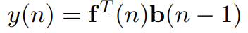
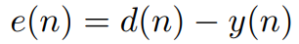
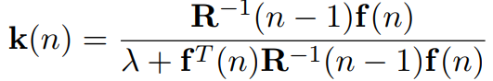
RLS algorithm summary
Calculate y(n) based on previous found weights:
Find error:
Calculate Kalman gain:
Update Correlation Matrix:
Calculate weights:
Where f(n) is the received signal over the noisy channel

Slide 12
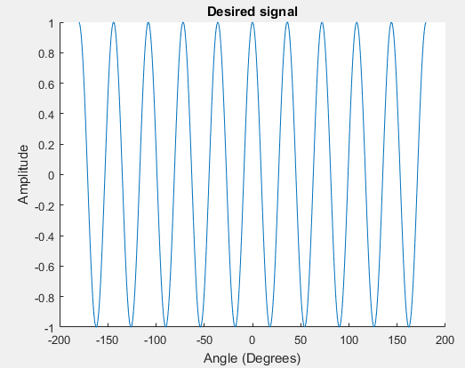
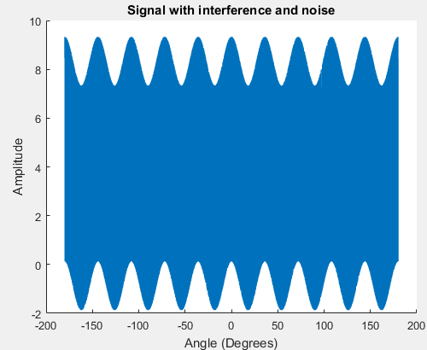
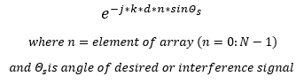
Application to antenna arrays
Create desired sinusoidal signal at a given angle
Have two interference patterns at given angles as well as random noise from each element of the antenna array
Multiply signals by steering vector given by:
Sum the steering vector multiplication and the random noise
This will simulate the receive signal in the array, f(n)

Slide 13
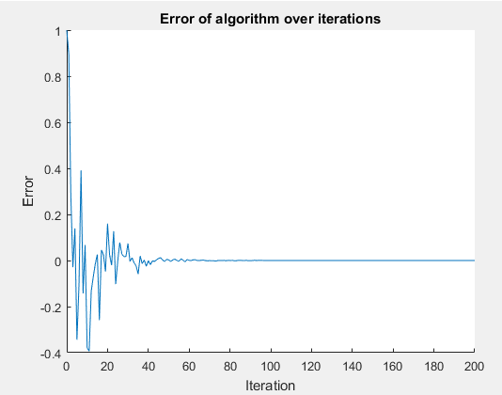
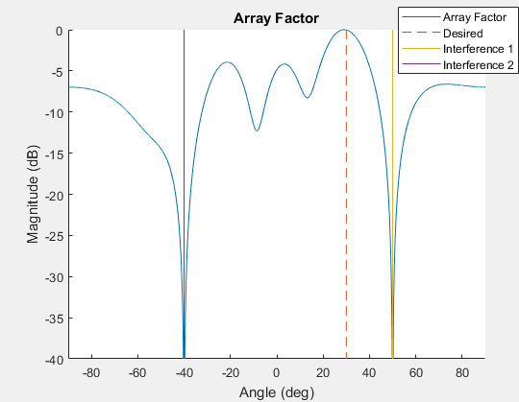
Results
Algorithm ran with following parameters:
N = 6 (number of elements in array)
d = 0.5ƛ
Desired signal at 30 degrees
Interference signals at 50 and -40 degrees
200 iterations
Forgetting Factor = 0.99

Slide 14
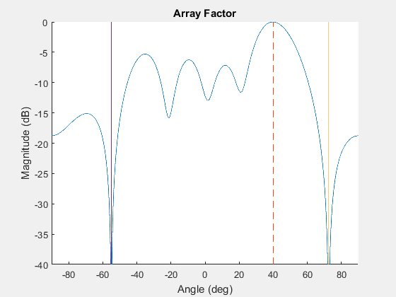
Results
Array factor as the desired signal and interference signals change

Slide 15
References
[1]https://ocw.mit.edu/courses/mechanical-engineering/2-161-signal-processing-continuous-and-discrete-fall-2008/study-materials/rls.pdf
http://www.cs.tut.fi/~tabus/course/ASP/LectureNew10.pdf

